Slide 1
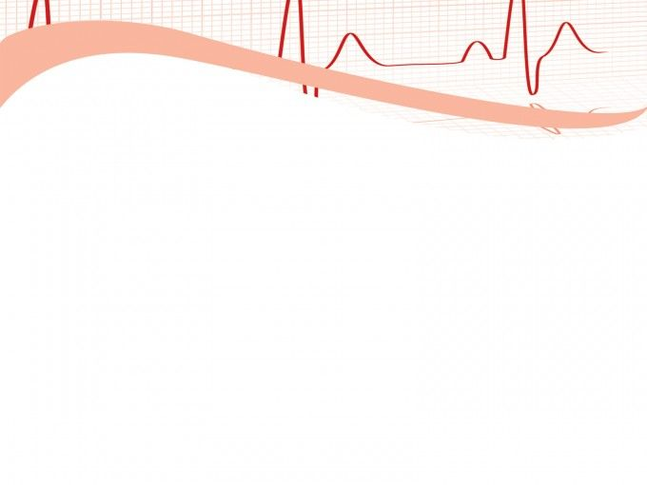
Project Lifeline
Seamless Patient Monitoring on the Move
ID-26
TECH LUMINATORS

Slide 2

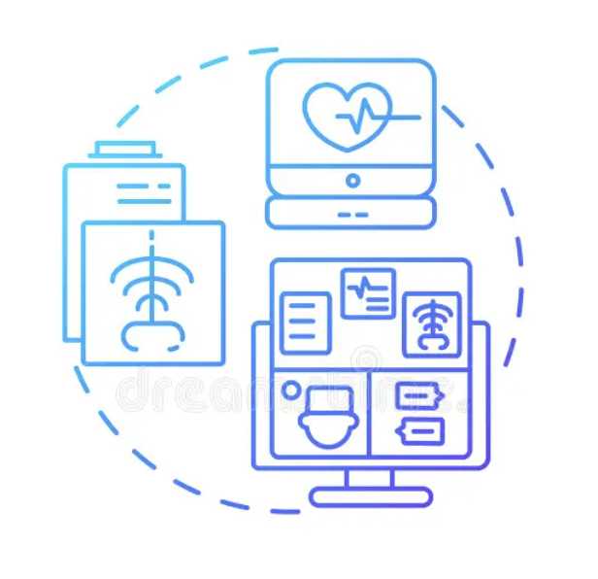

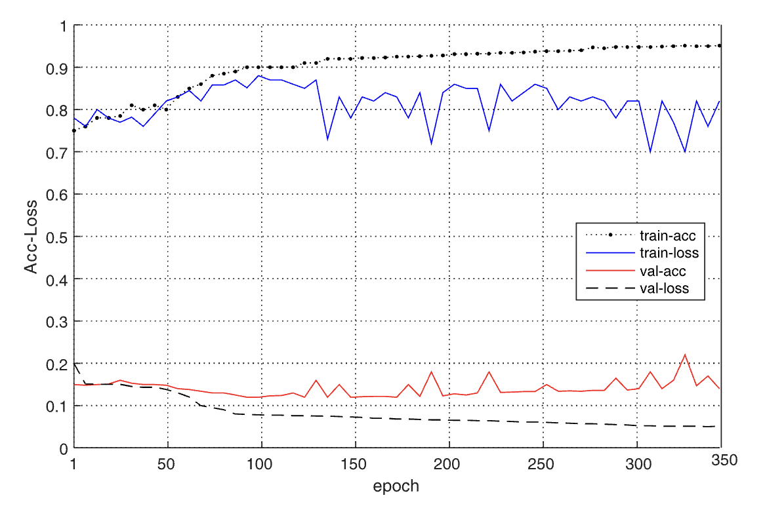
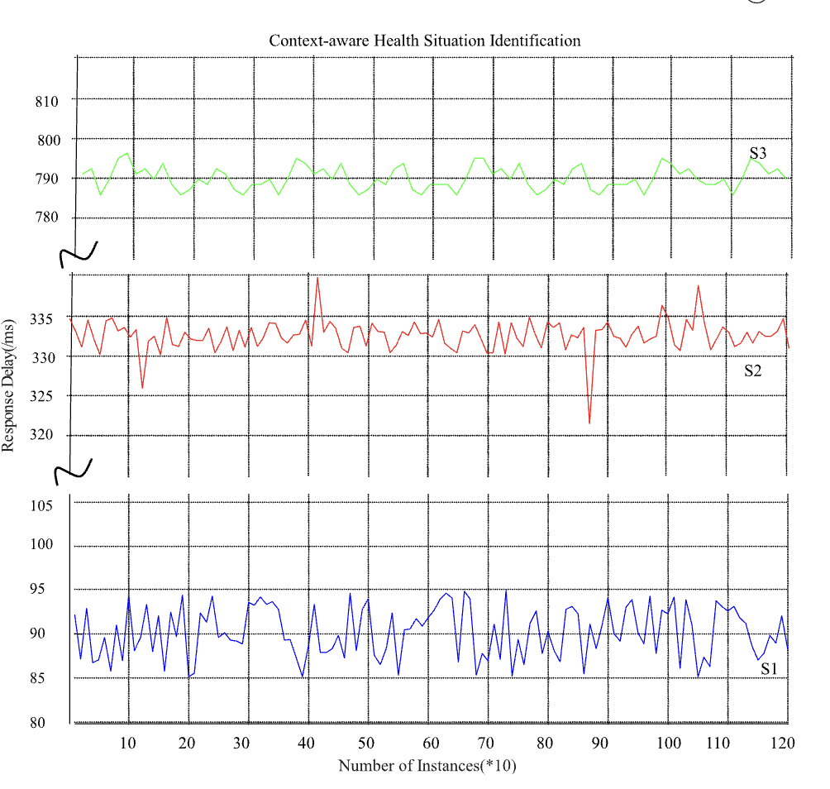

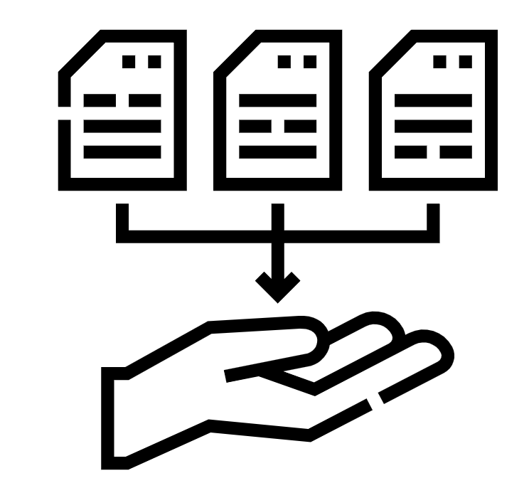
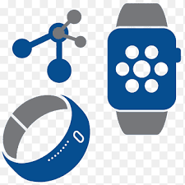
Revolutionizing Patient Care
Seamless Monitoring & Data Continuity Across Care Pathways
Challenges
Proposed Solution
Business Impact
The primary objective is to enhance patient outcomes by ensuring timely interventions and personalized care based on real-time monitoring data. This includes reducing readmission rates, minimizing medical errors, and optimizing treatment plans through data-driven insights generated by continuous monitoring across care pathways.
Implementing a seamless monitoring and data continuity solution can lead to significant operational efficiencies within healthcare institutions. This includes streamlining workflows, reducing manual data entry errors, optimizing resource utilization, and ultimately lowering overall healthcare costs associated with patient care and management.
Implementation of 5G-enabled Remote Monitoring System
Utilize wearable sensors and medical devices with embedded 5G connectivity for real-time transmission of patient vital signs data.
Integrate advanced analytics and machine learning algorithms to analyze data in real-time, enabling early detection of abnormalities and timely interventions.
Deployment of Telemedicine and Teleconsultation Services
Utilize 5G-enabled telemedicine solutions to facilitate remote consultations between patients and healthcare providers.
Integrate electronic health record systems with telemedicine platforms for seamless access to patient data during remote consultations, ensuring continuity of care.
The 5GSS framework transforms healthcare by minimizing latency, increasing reliability, ensuring data security, and accurately identifying health situations with an accuracy rate of 94.36%.
This enhances patient care, streamlines operations, and fosters stakeholder trust. Expected to generate $4.5 million in revenue over two years, it offers substantial growth opportunities for healthcare providers through improved services, operational efficiency, and enhanced data accuracy.
Technical Solution
Snapshots
Privacy- Preserving Data Collection
Remote Monitoring System
Therapeutic Plan
IPv6, 5G Connectivity, Advanced Analytics, Telemedicine Solutions

Slide 3
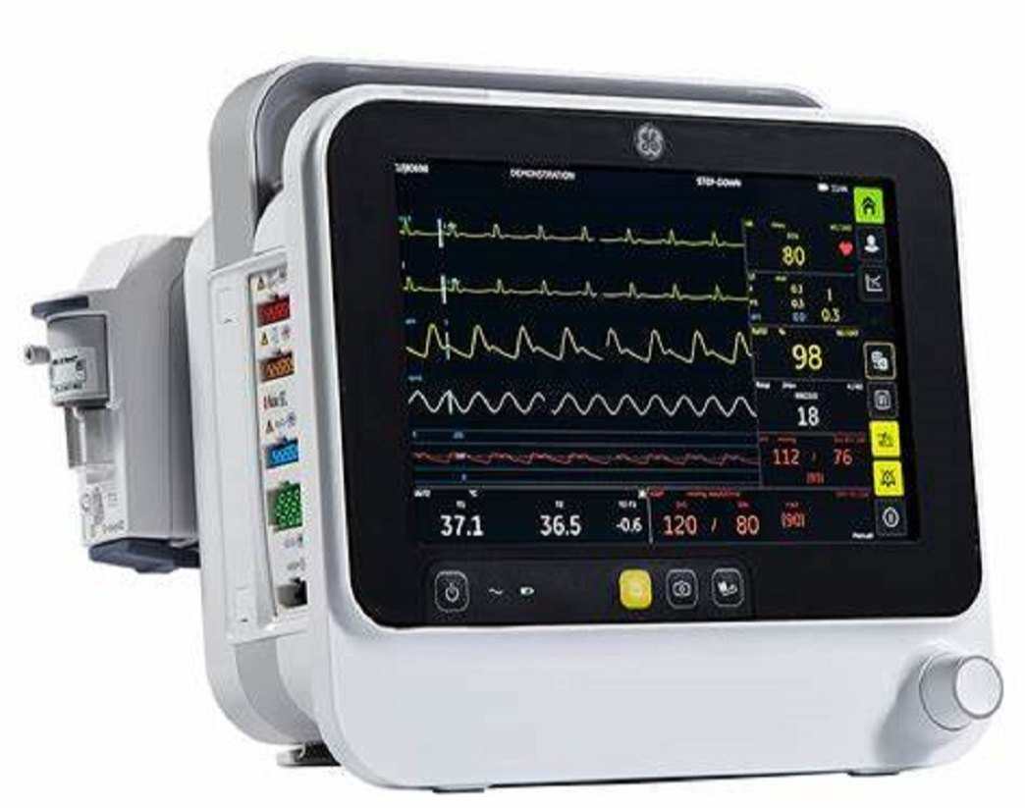
DATA ACQUISITION
Empower comprehensive patient care with B1x5M monitors, ensuring continuous vital sign monitoring.
Existing Sensors:-
Electrocardiogram (ECG)
Blood pressure (BP)
Pulse oximetry (SpO2)
Respiratory rate (RR)
New Sensors:-
Blood Glucose Sensor
Temperature Sensor
EMG (Electromyography)
Glasgow Coma Scale (GCS)
Holter Monitor

Slide 4
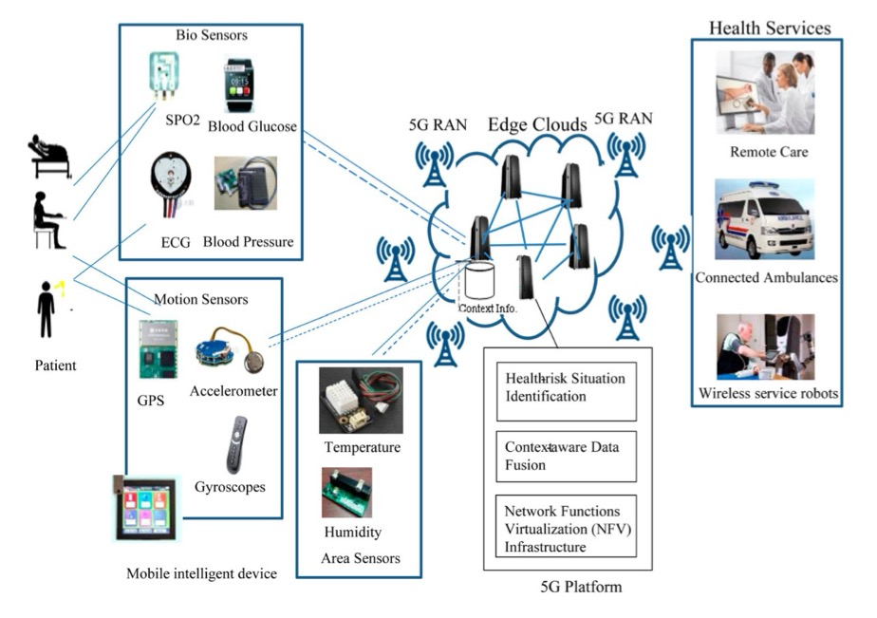
DATA TRANSMISSION
B1x5M MONITOR

Slide 5
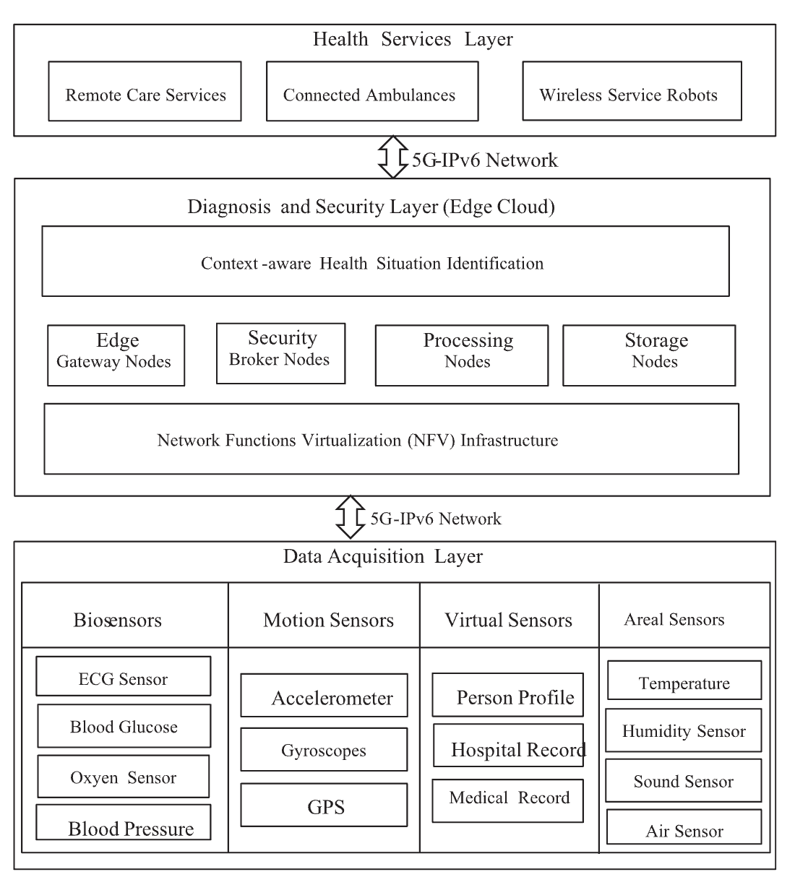
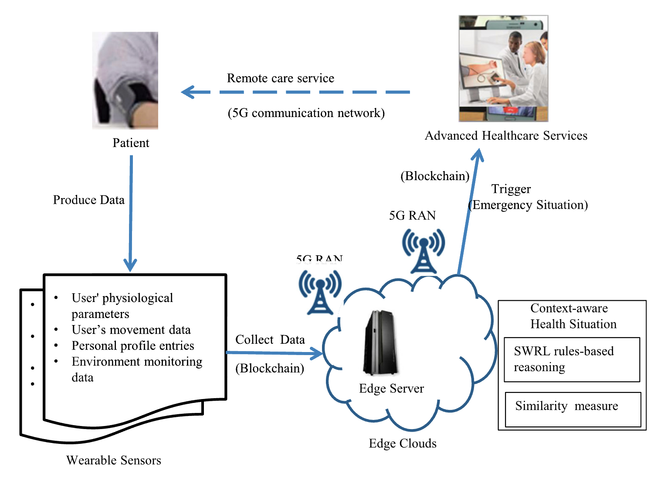
ARCHITECTURE
B1x5M MONITOR
SMAG

Slide 6
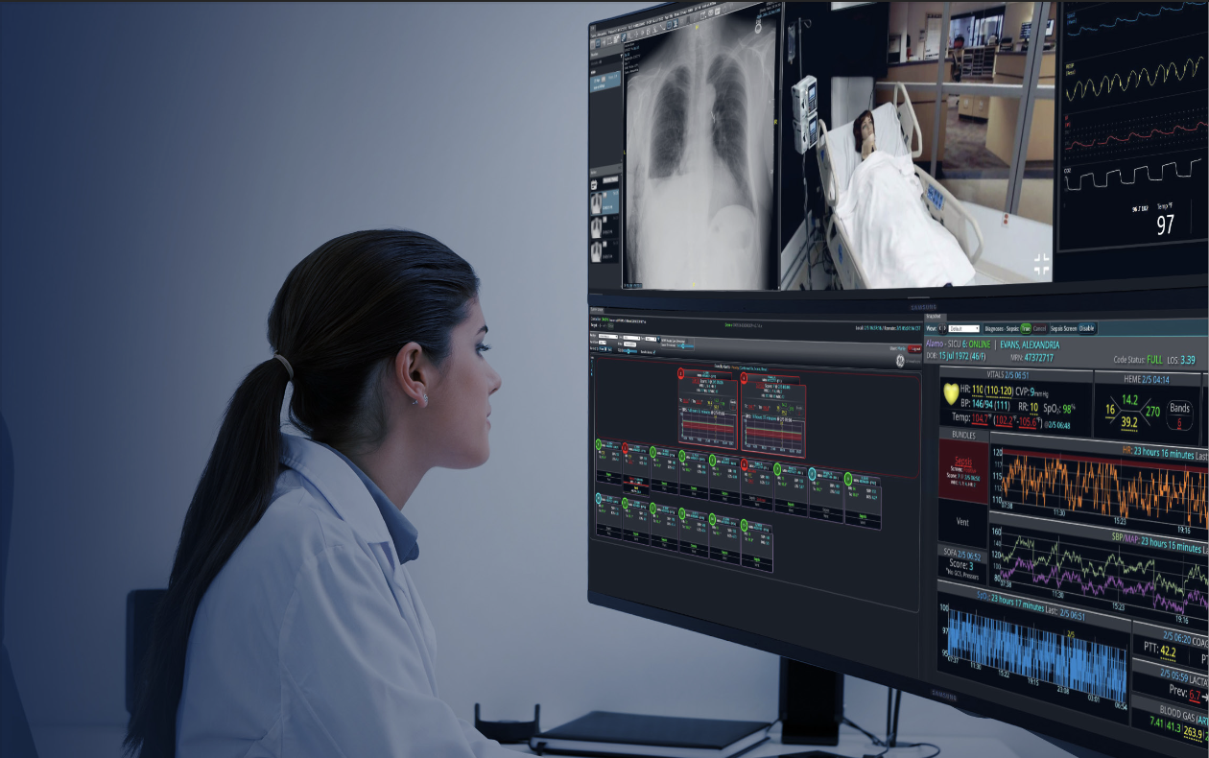
DATA HUB
Seamlessly integrate vital data streams from ambulances via 5G and hospital EMR systems for holistic patient monitoring.
Harness Mural's dynamic capabilities to visualize real-time patient data, empowering healthcare providers with actionable insights.
Elevate patient care with AI-driven anomaly detection, enabling proactive alerts and personalized interventions for optimal outcomes.

Slide 7
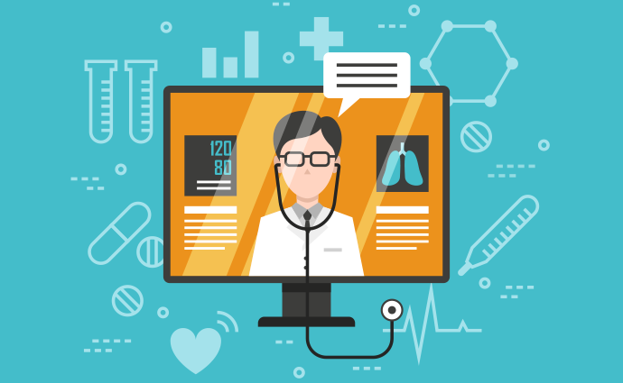
TELEMEDICINE SERVICES

Slide 8
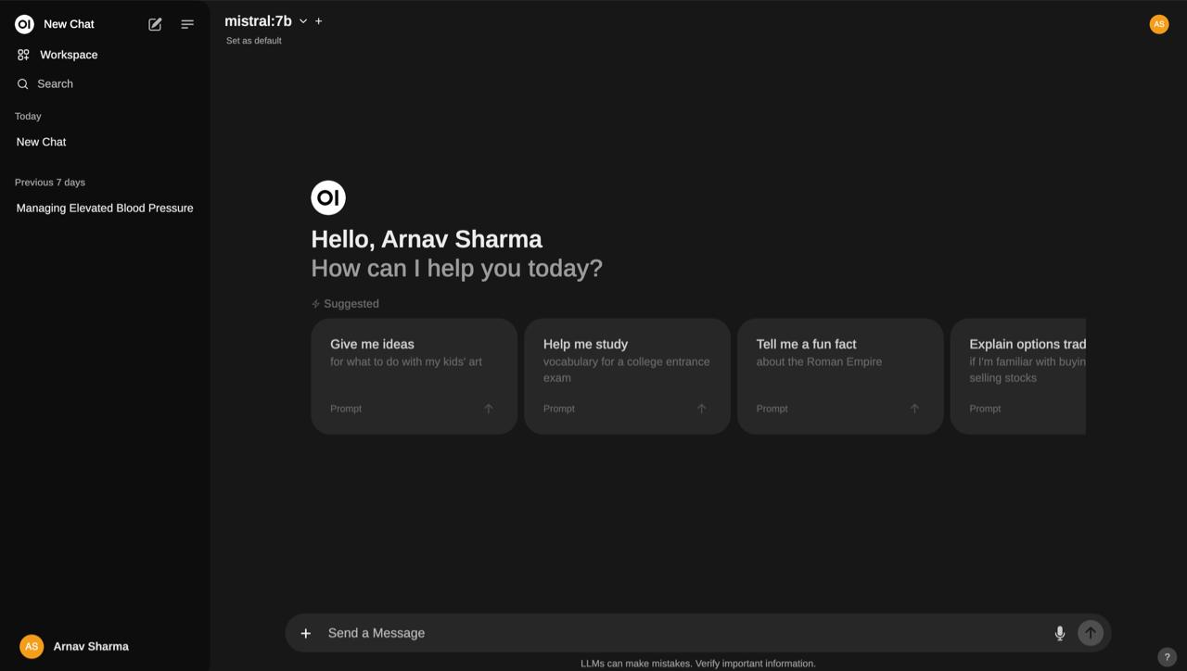
CHATBOT SERVICES

Slide 9
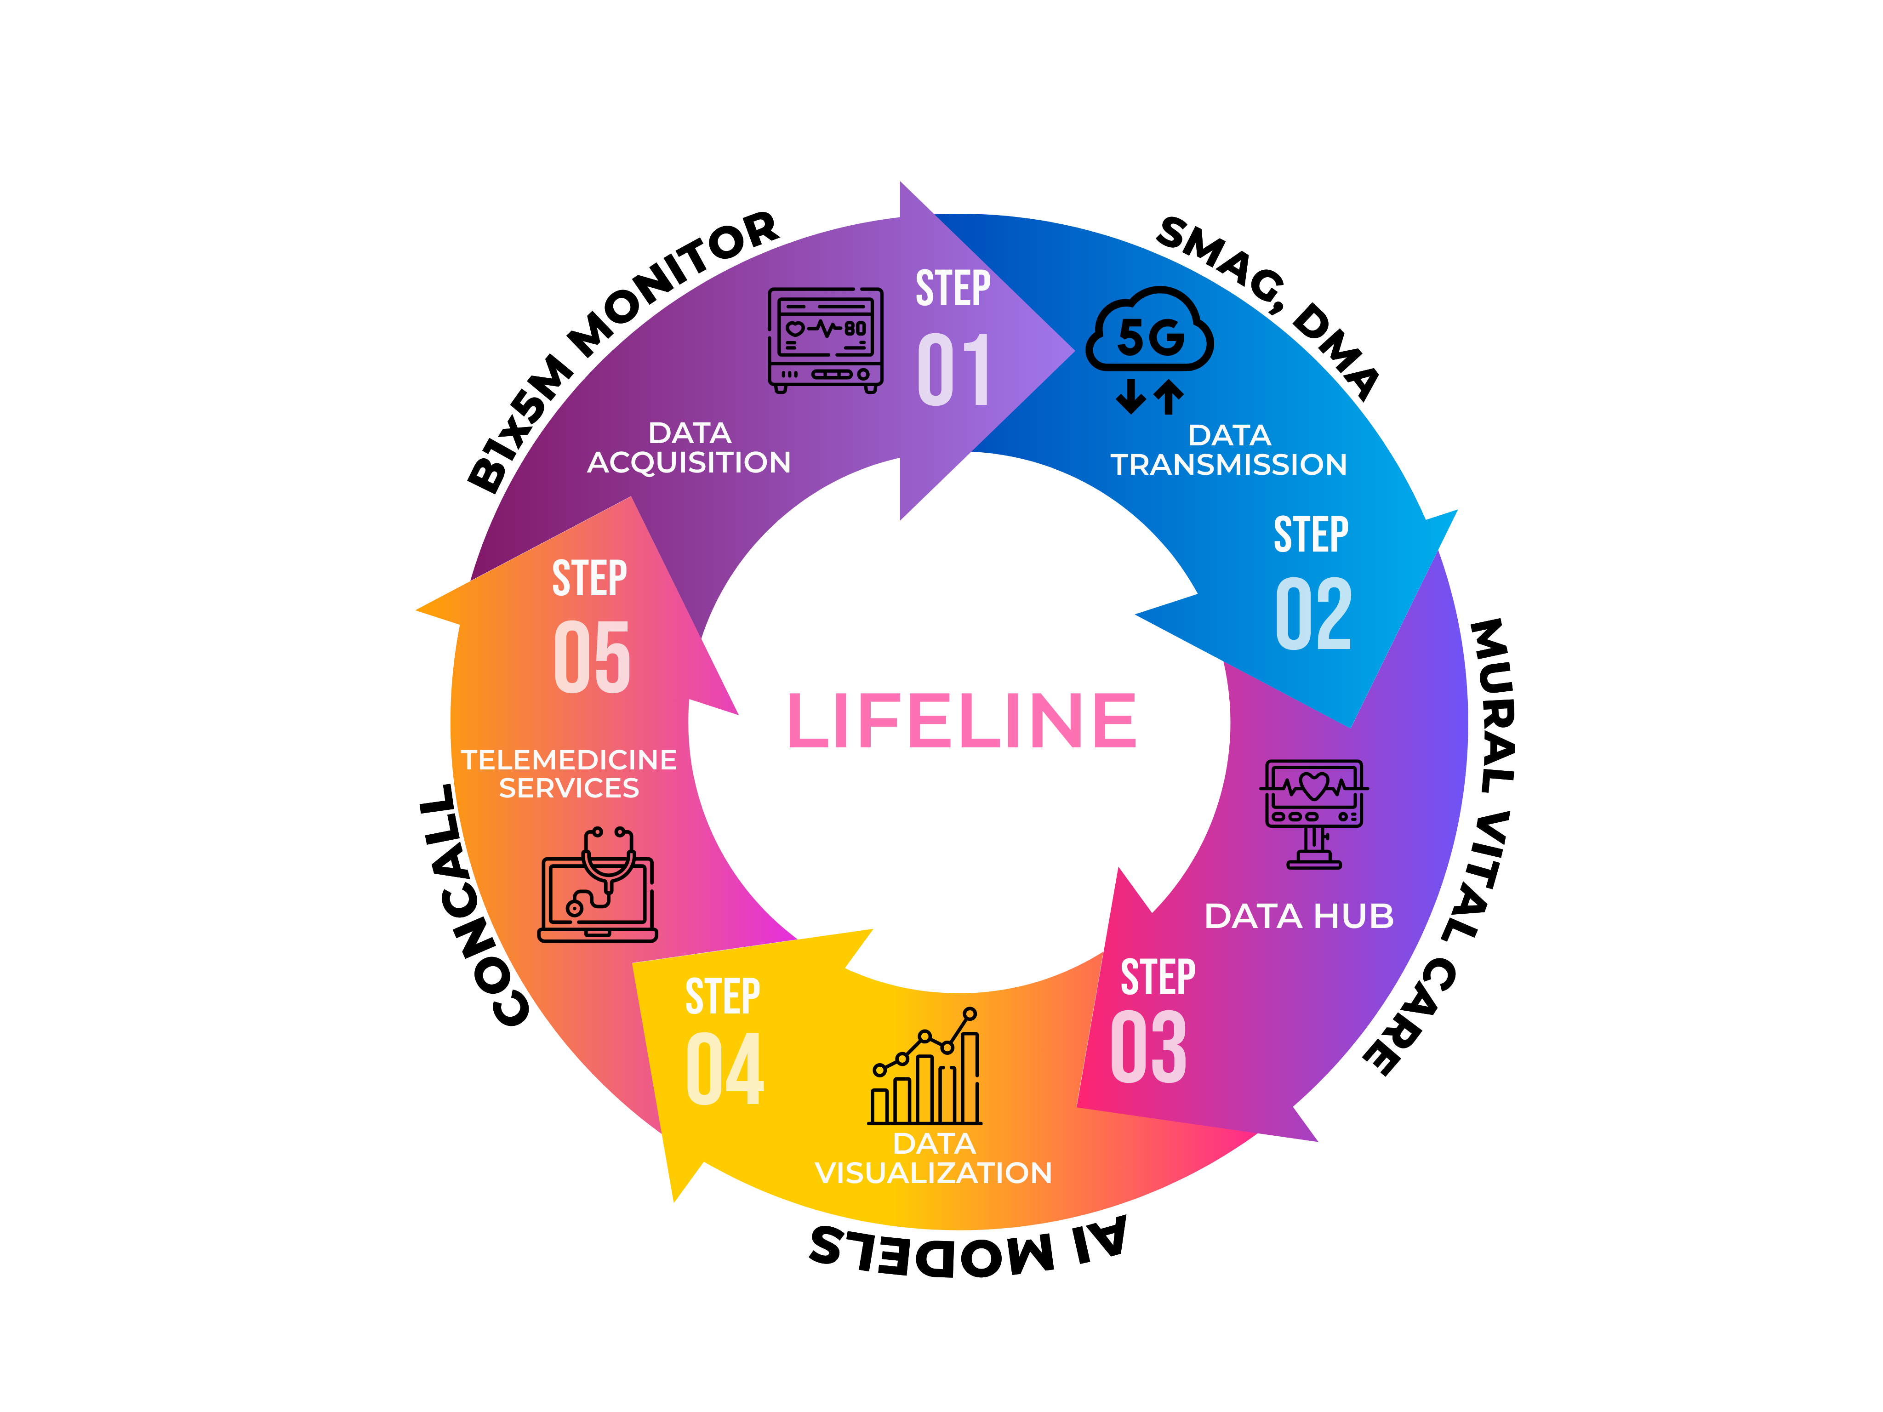
WORKFLOW

Slide 10
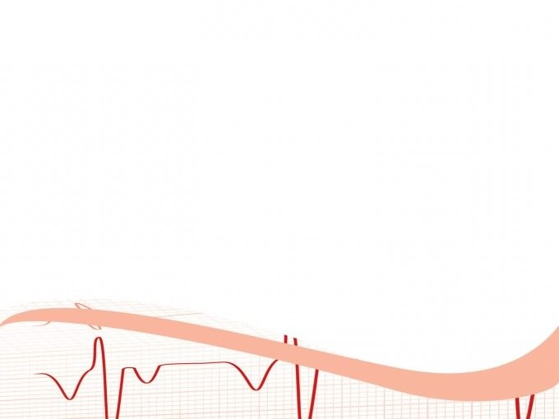
THANK YOU
ID-26
TECH LUMINATORS

